Slide 1
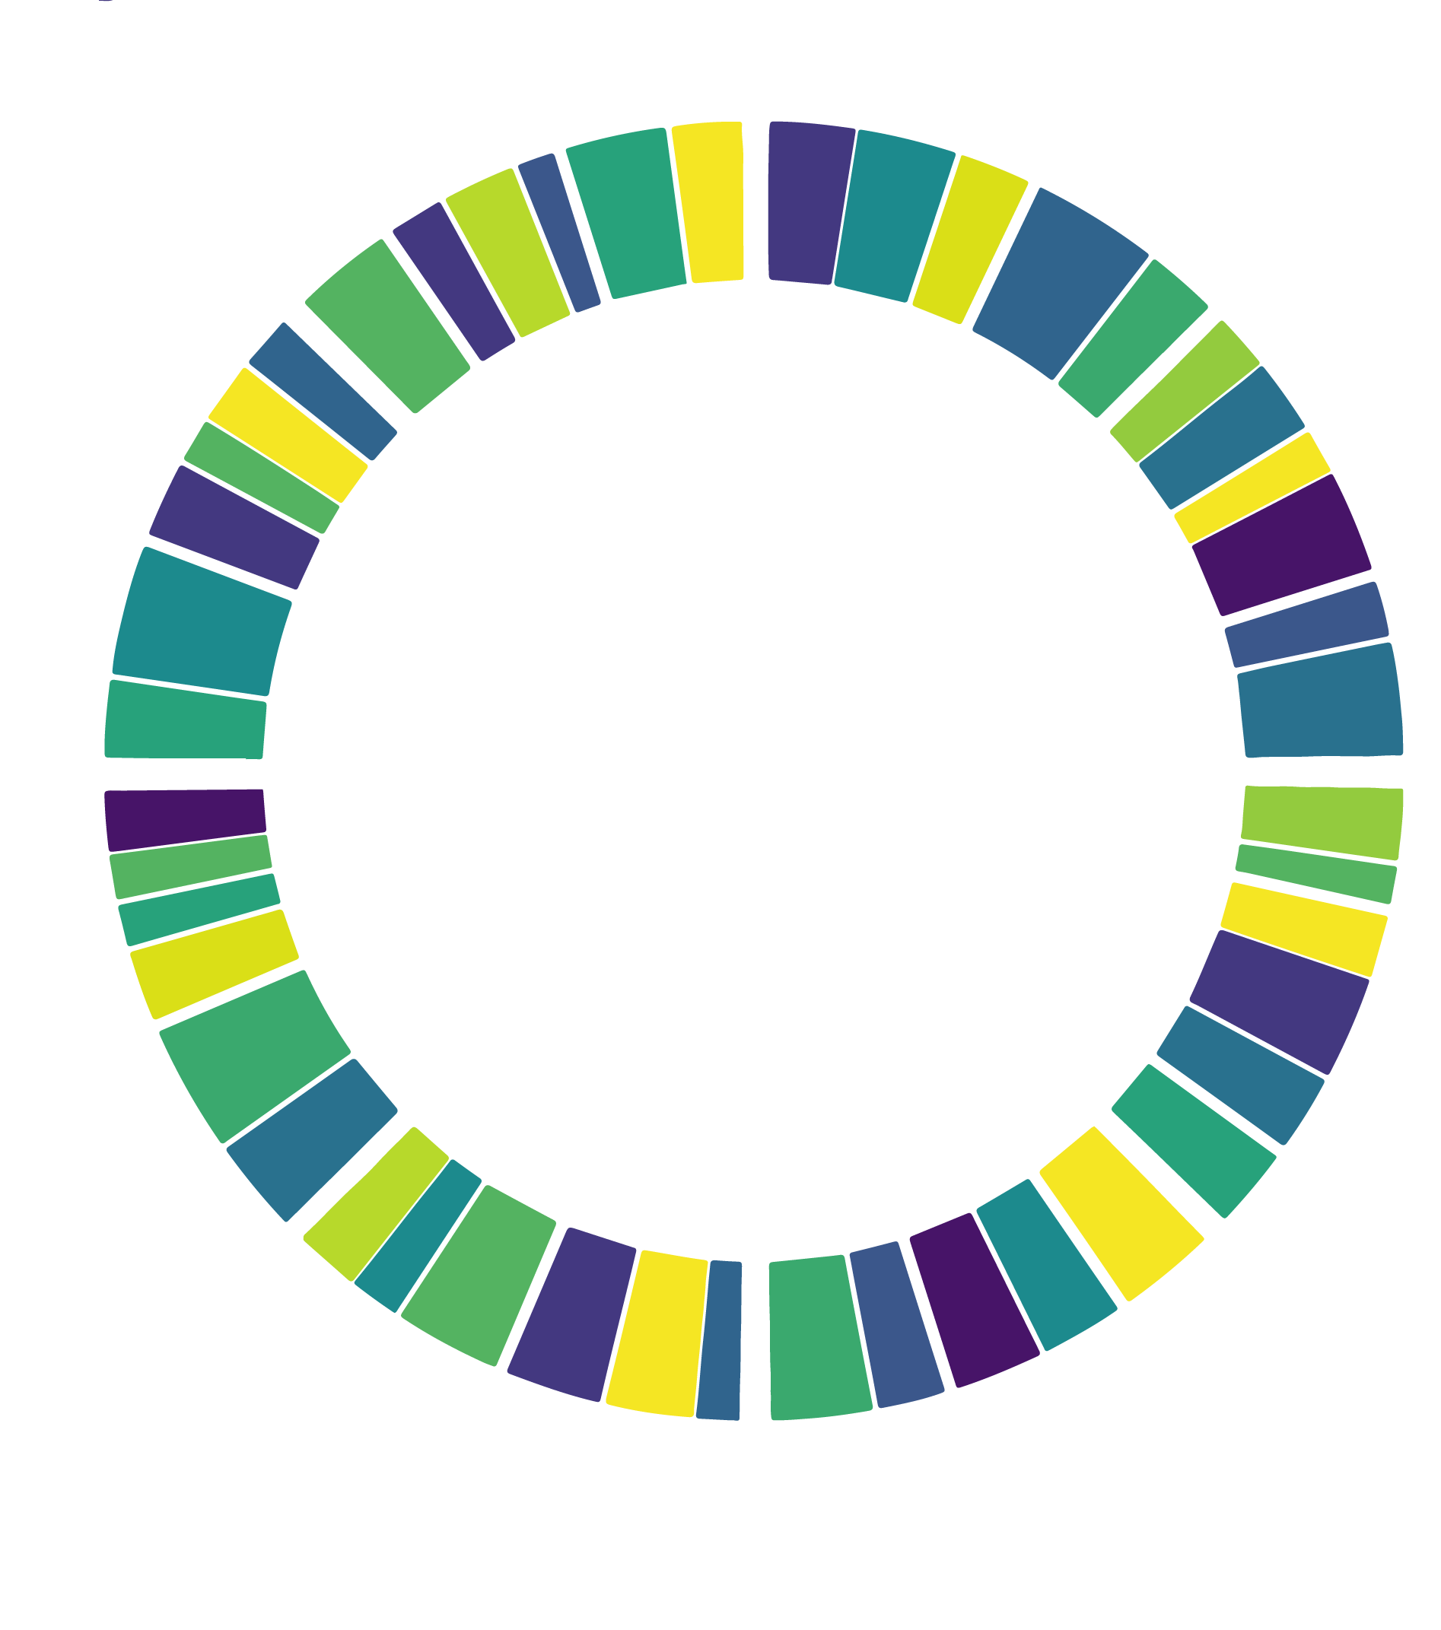
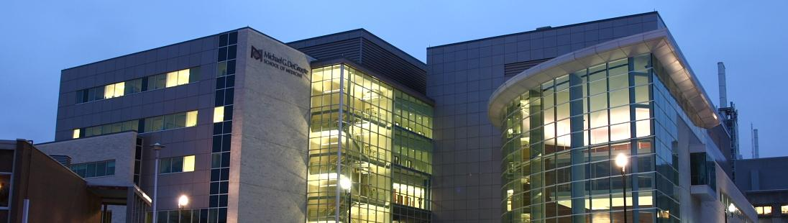
Genomic epidemiology in the time of SARS-CoV-2
Andrew G. McArthur
Michael G. DeGroote Institute for Infectious Disease Research
David Braley Center for Antibiotic Discovery
Department of Biochemistry & Biomedical Sciences
McMaster University, Canada
mcarthurbioinformatics.ca I oncov.ca I iidr.mcmaster.ca

Slide 2




Slide 3
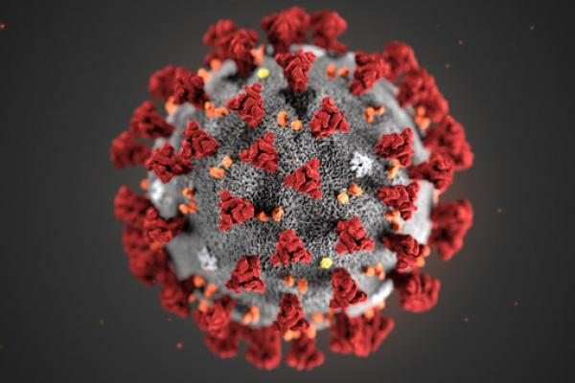
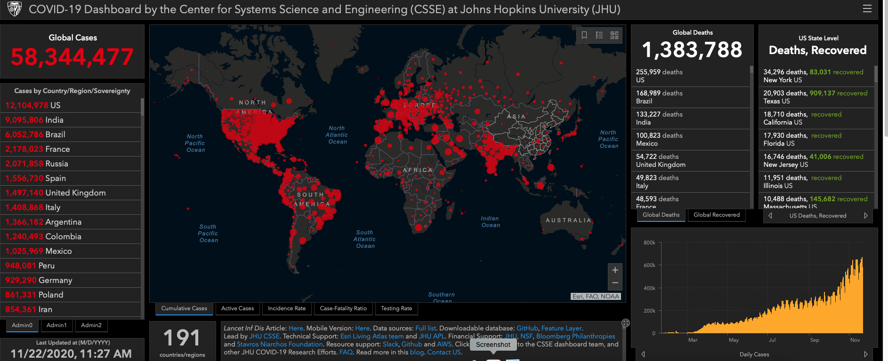
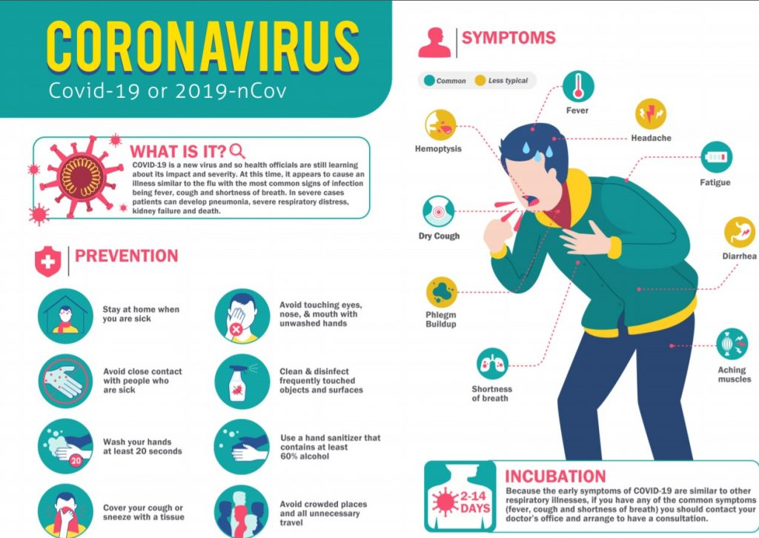
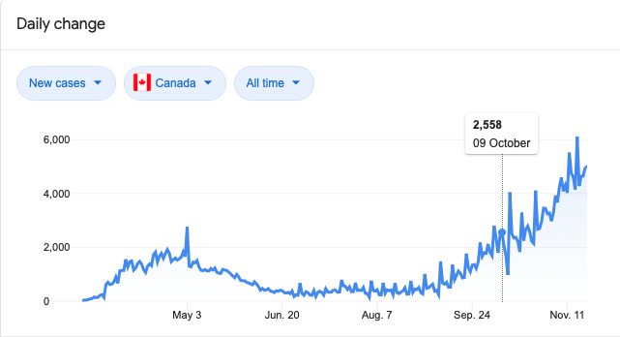
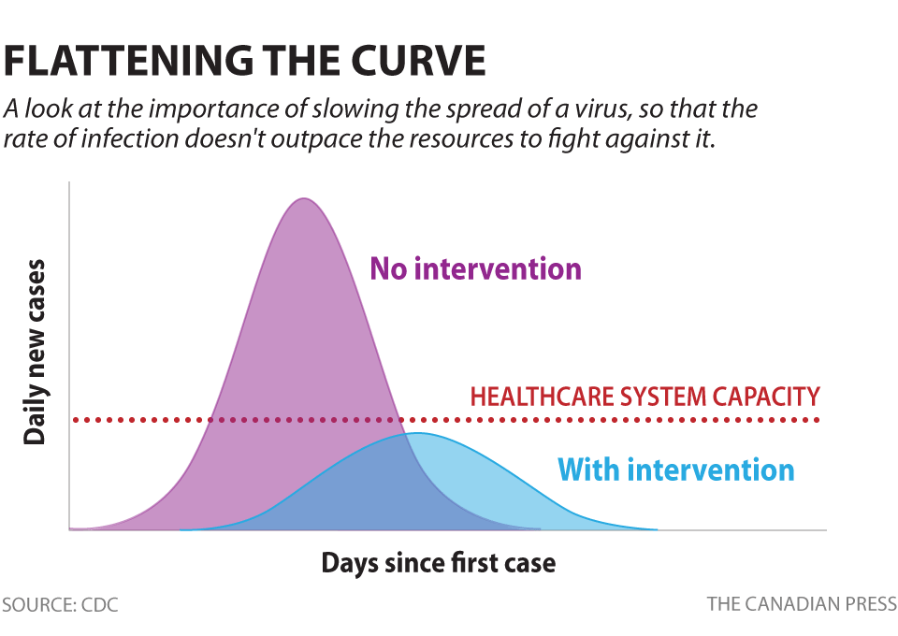
SARS-CoV-2

Slide 4


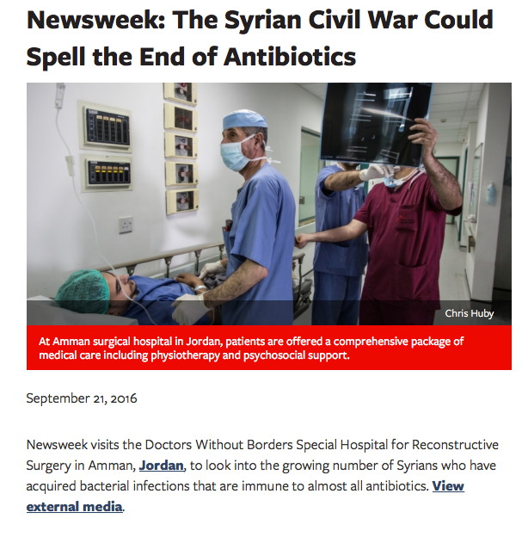


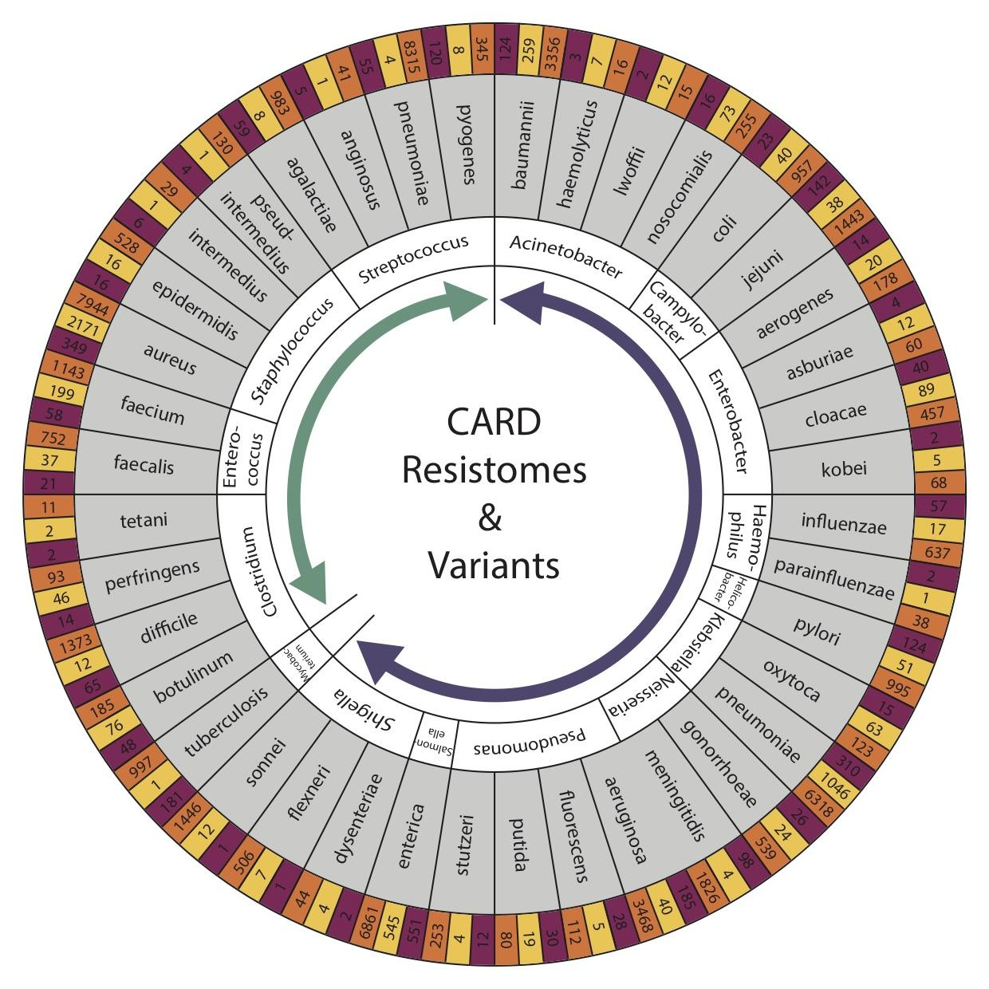


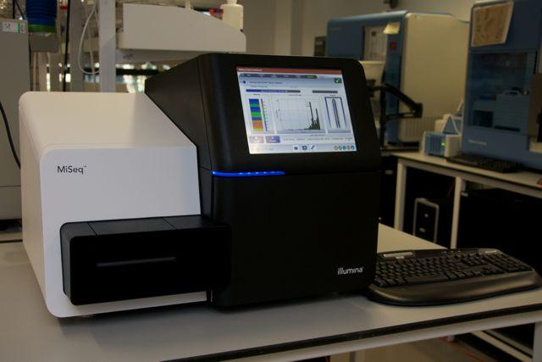
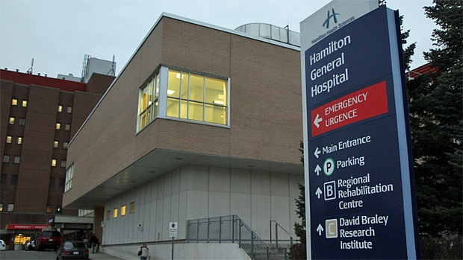

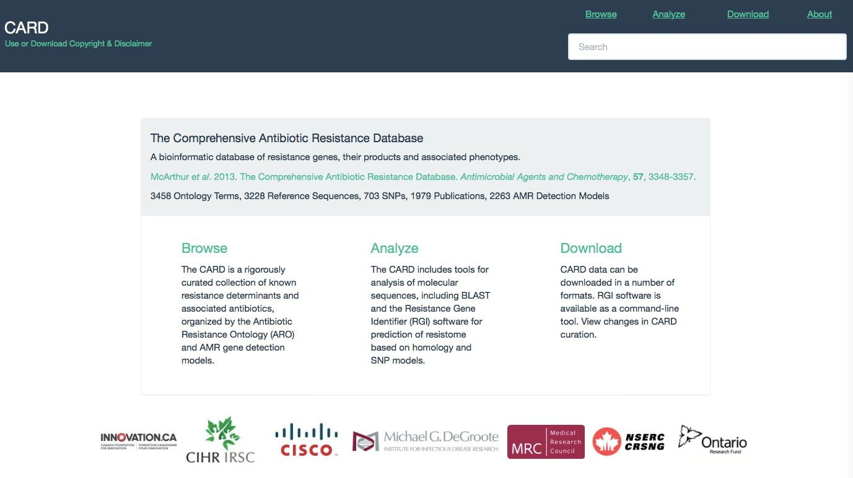
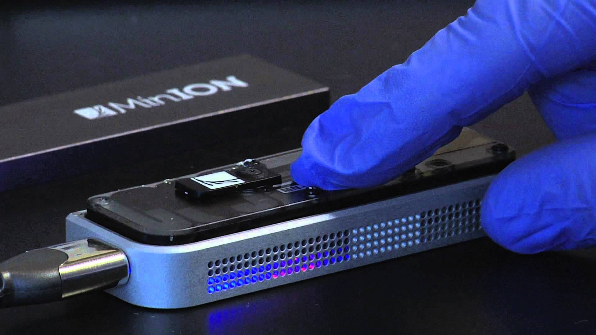
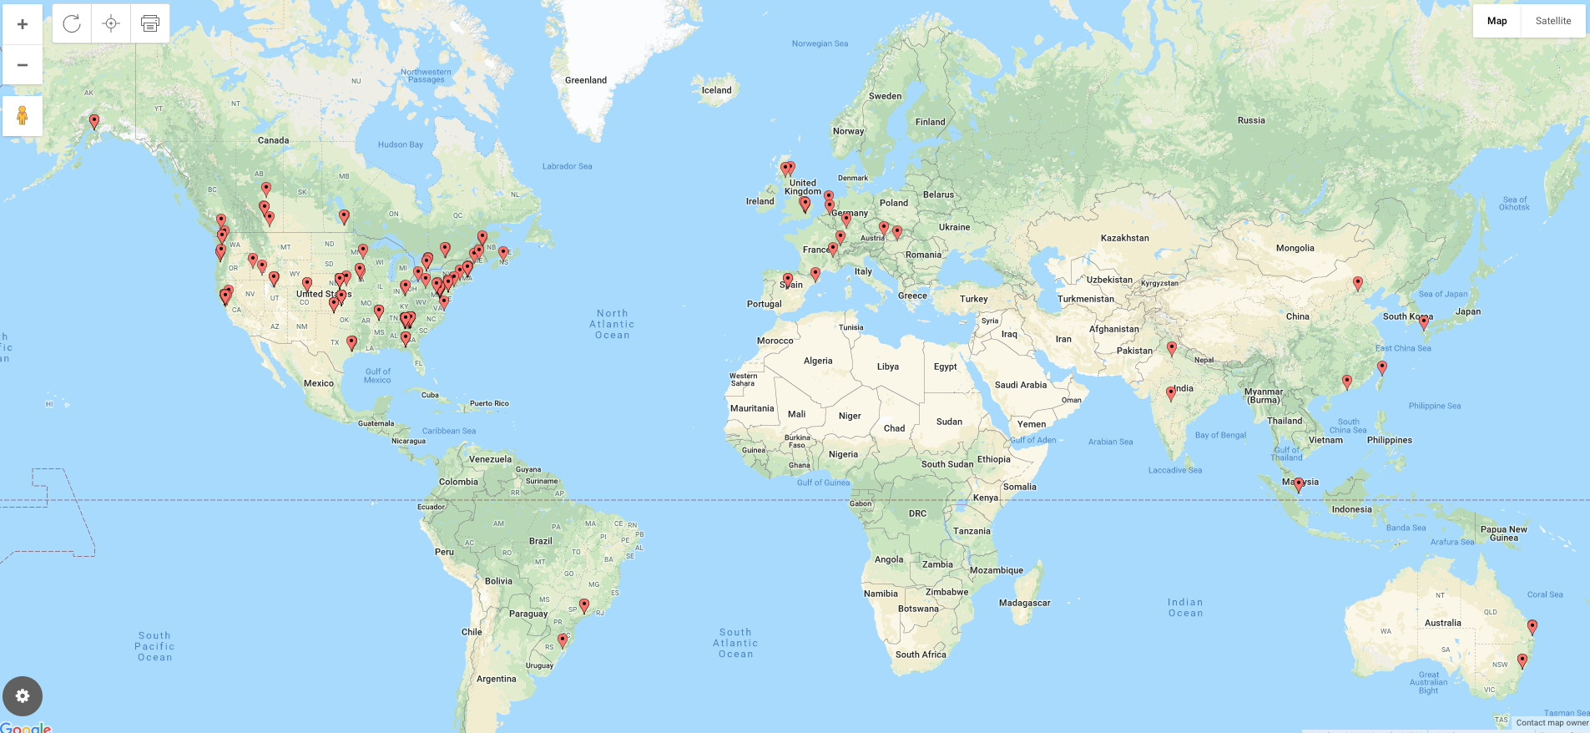
Antimicrobial Resistance
Analytics
Bioinformatics
DNA Sequencing
Biocuration
Public Health Agency Usage 2019
DETECT
DECODE
DEPLOY
patient
community
national & international
diagnostics
outbreaks
surveillance

Slide 5

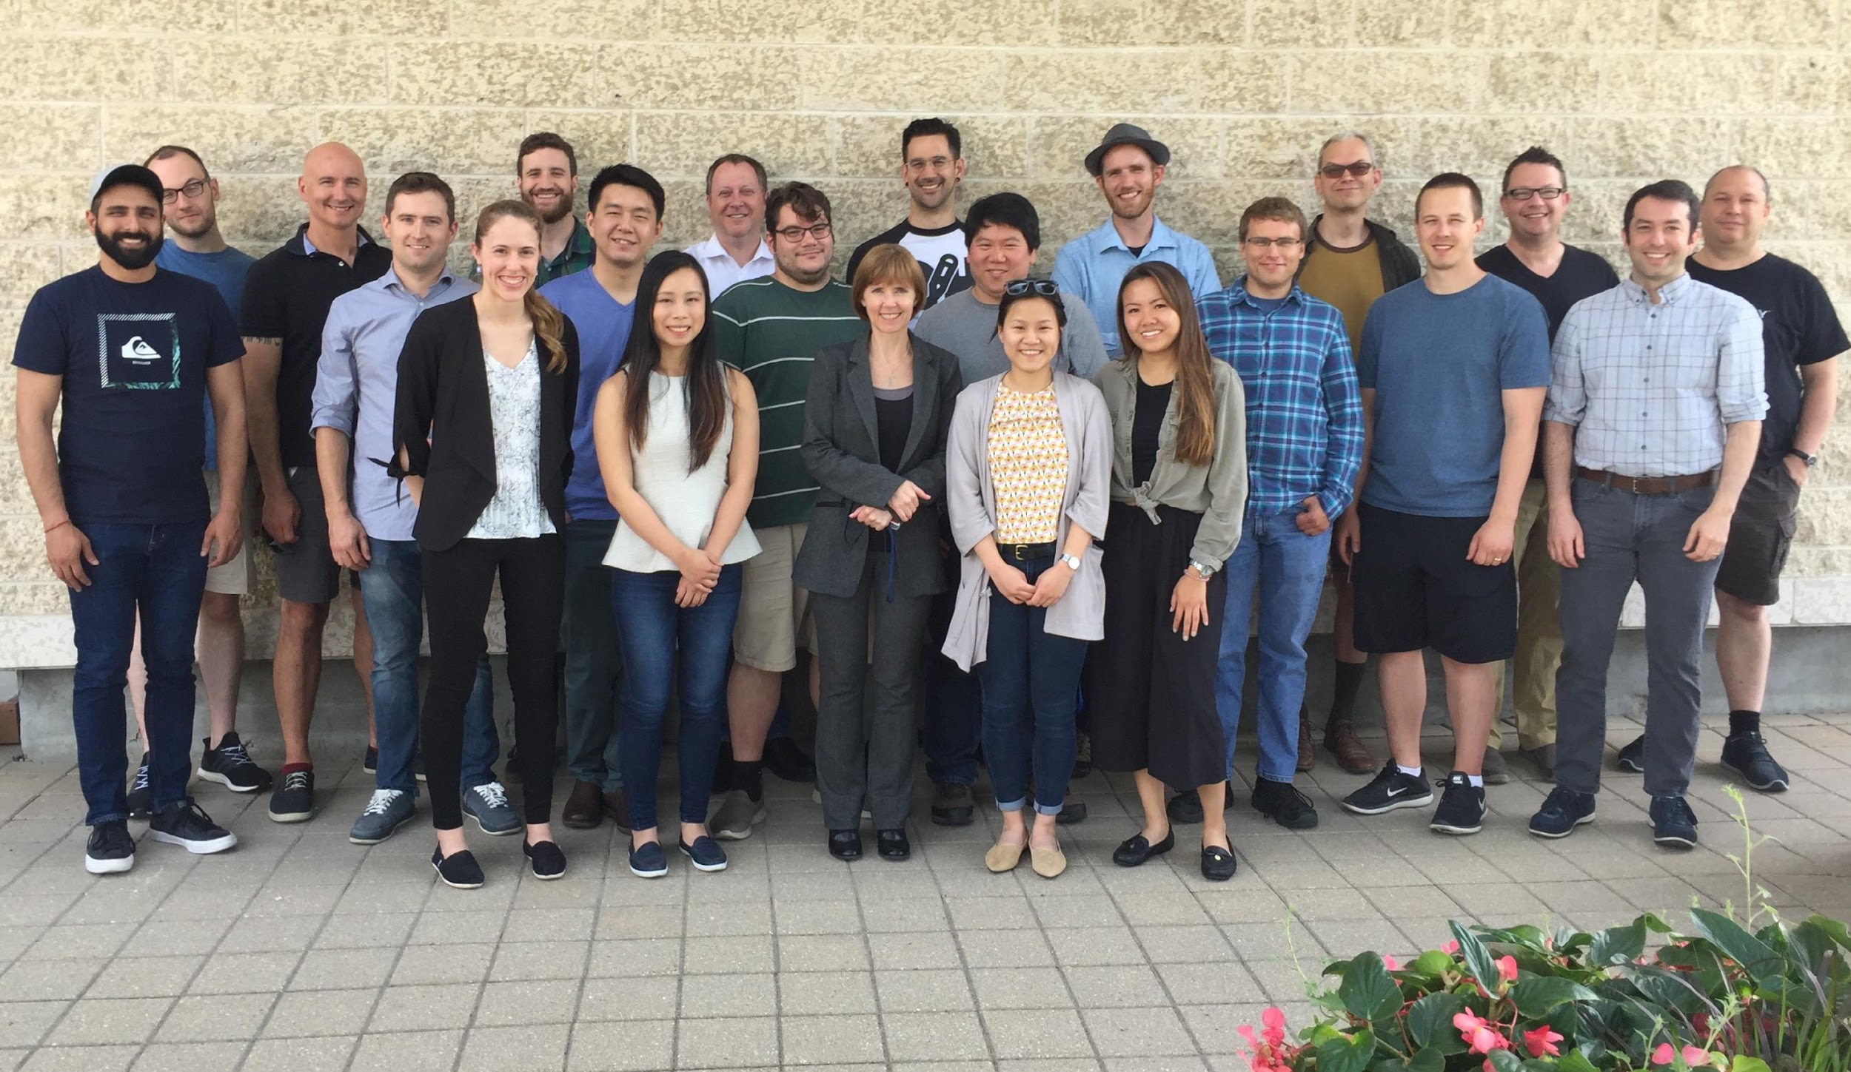

Integrated Rapid Infectious Disease Analysis (IRIDA) Platform - a Canadian-led open source, end-to-end platform for public health genomics

Slide 6
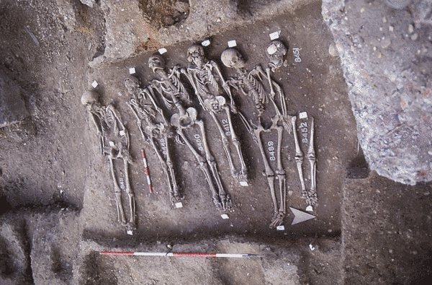
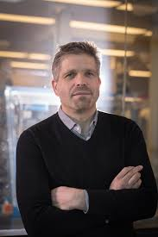


Integrated Rapid Infectious Disease Analysis (IRIDA) Platform - a Canadian-led open source, end-to-end platform for public health genomics
Hendrick Poinar

Slide 7
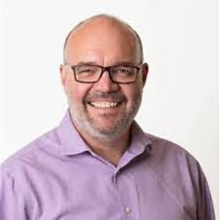
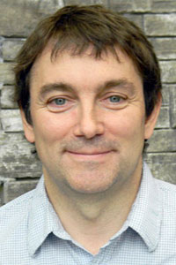
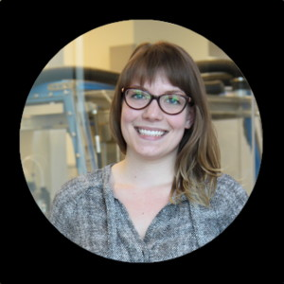
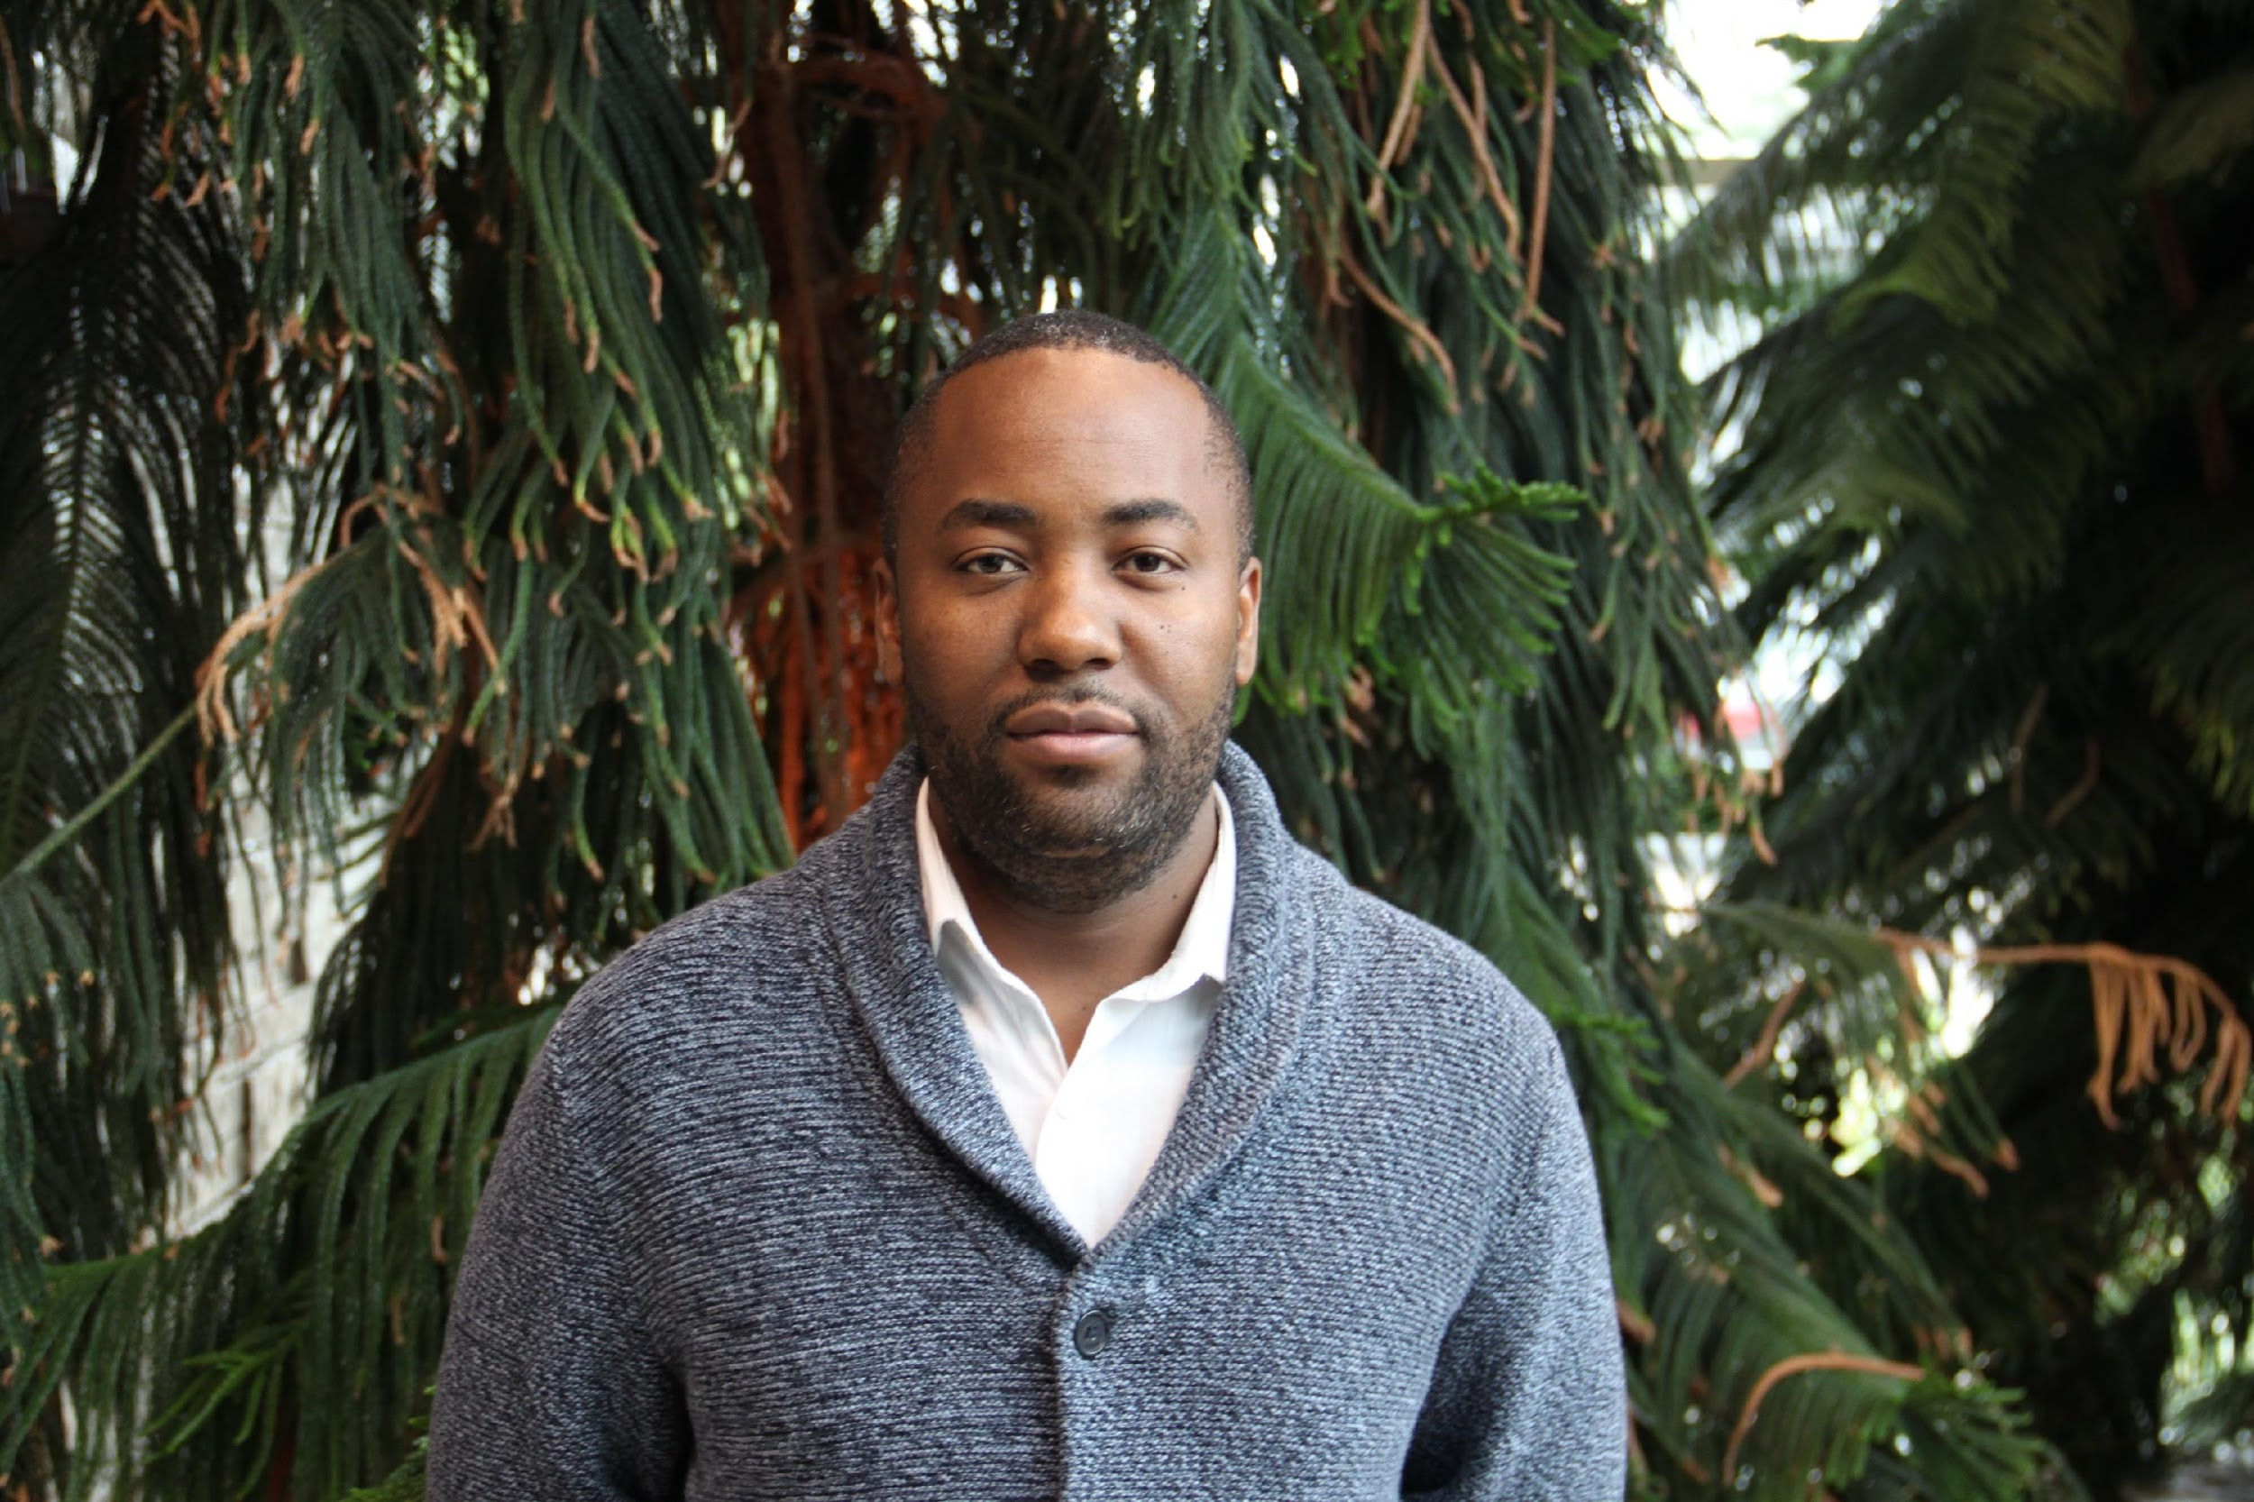
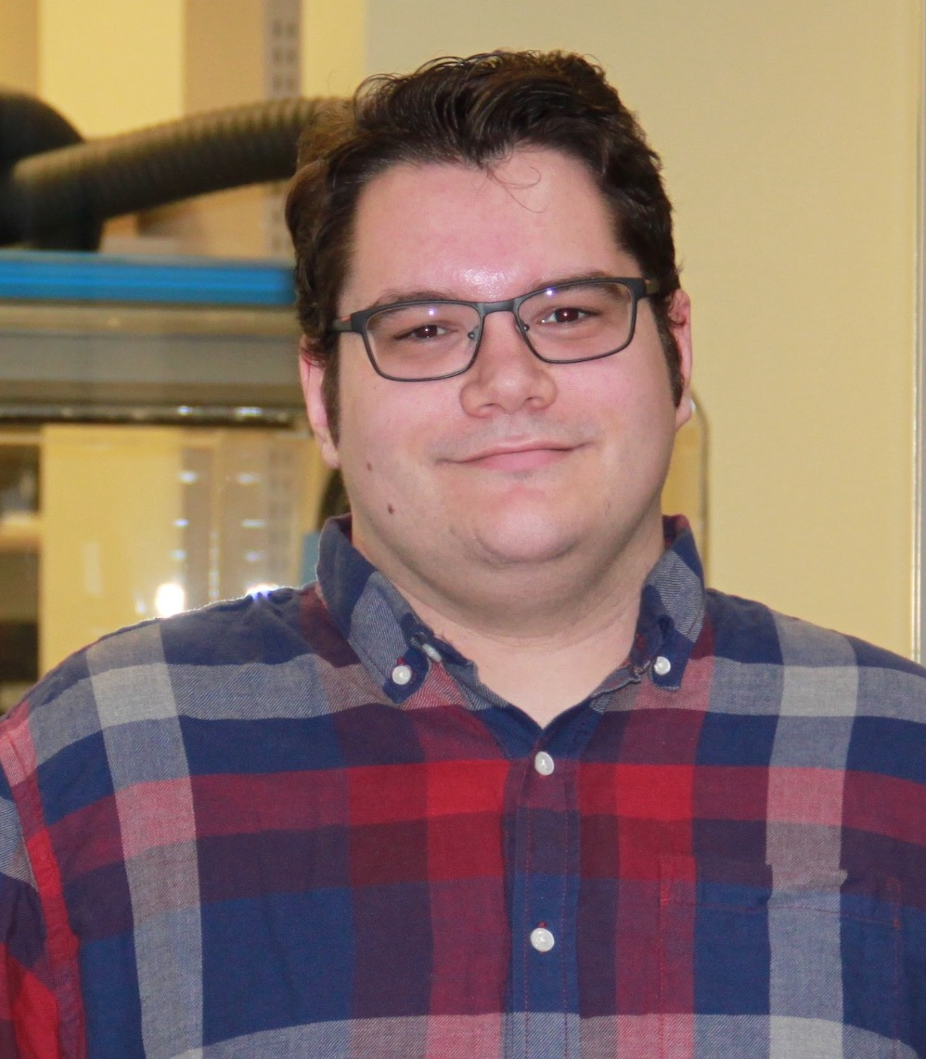
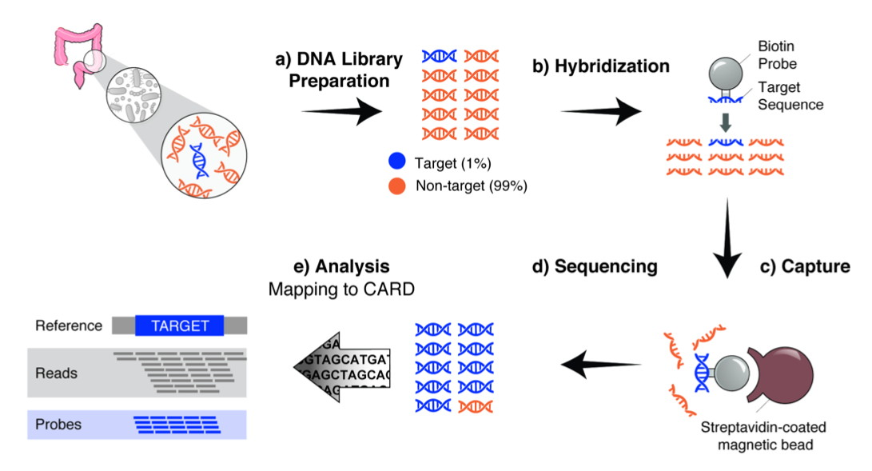
AMR Bait Capture
Allison Guitor, Ph.D. student
(Wright Lab)
Amos Raphenya
Lead CARD Developer
Brian Alcock
Lead CARD Curator
Hendrick Poinar
Gerry Wright
Mike Surette
Guitor et al. 2019. Antimicrobial Agents and Chemotherapy, 64, e01324-19.

Slide 8
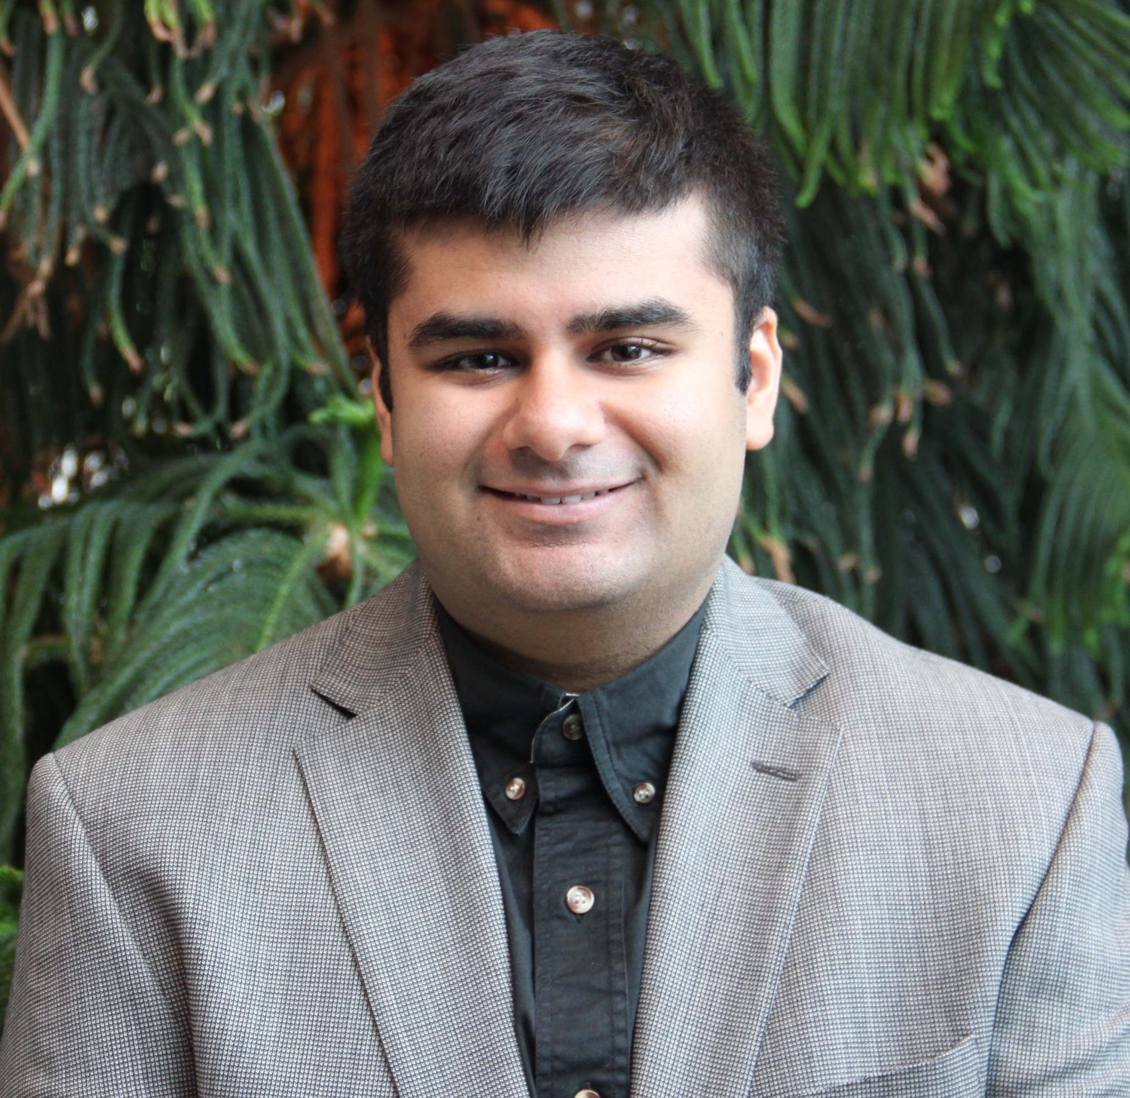
Summer 2019 – Viral Bait Capture
3 million available virus genome sequences
Existing design methods would result in over 85,000,000 hybridization baits
Hendrick Poinar
Jalees Nasir, PhD Student (McArthur Lab)

Slide 9
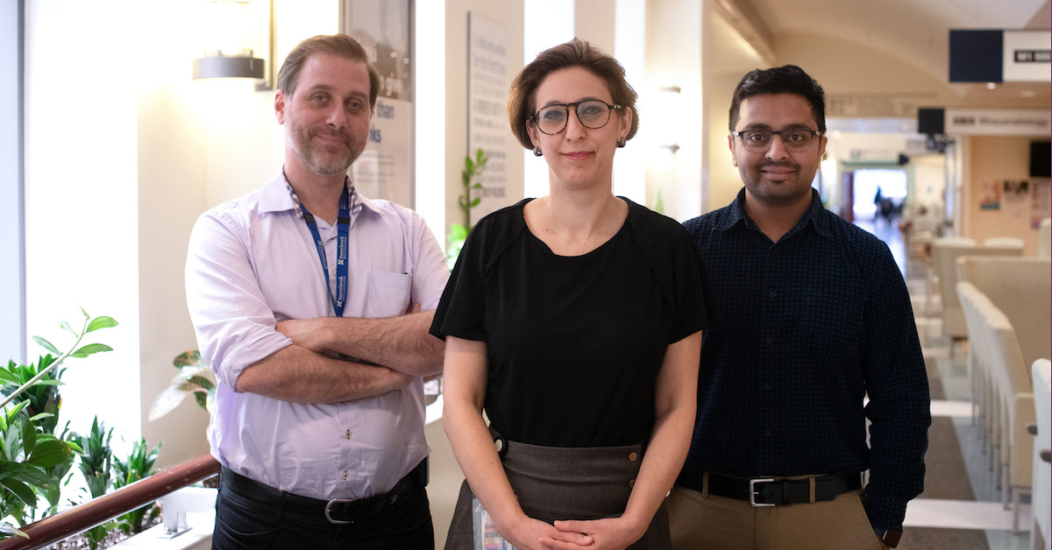
Summer 2019 – Viral Bait Capture
3 million available virus genome sequences
Existing design methods would result in over 85,000,000 hybridization baits
Hendrick Poinar
Jalees Nasir, PhD Student (McArthur Lab)
Syndromic bait sets
Focus on respiratory viruses first
30% are lacking diagnostic tools
Include seasonal and other coronaviruses
Robert Kozak, Samira Mubareka, Arinjay Banerjee

Slide 10
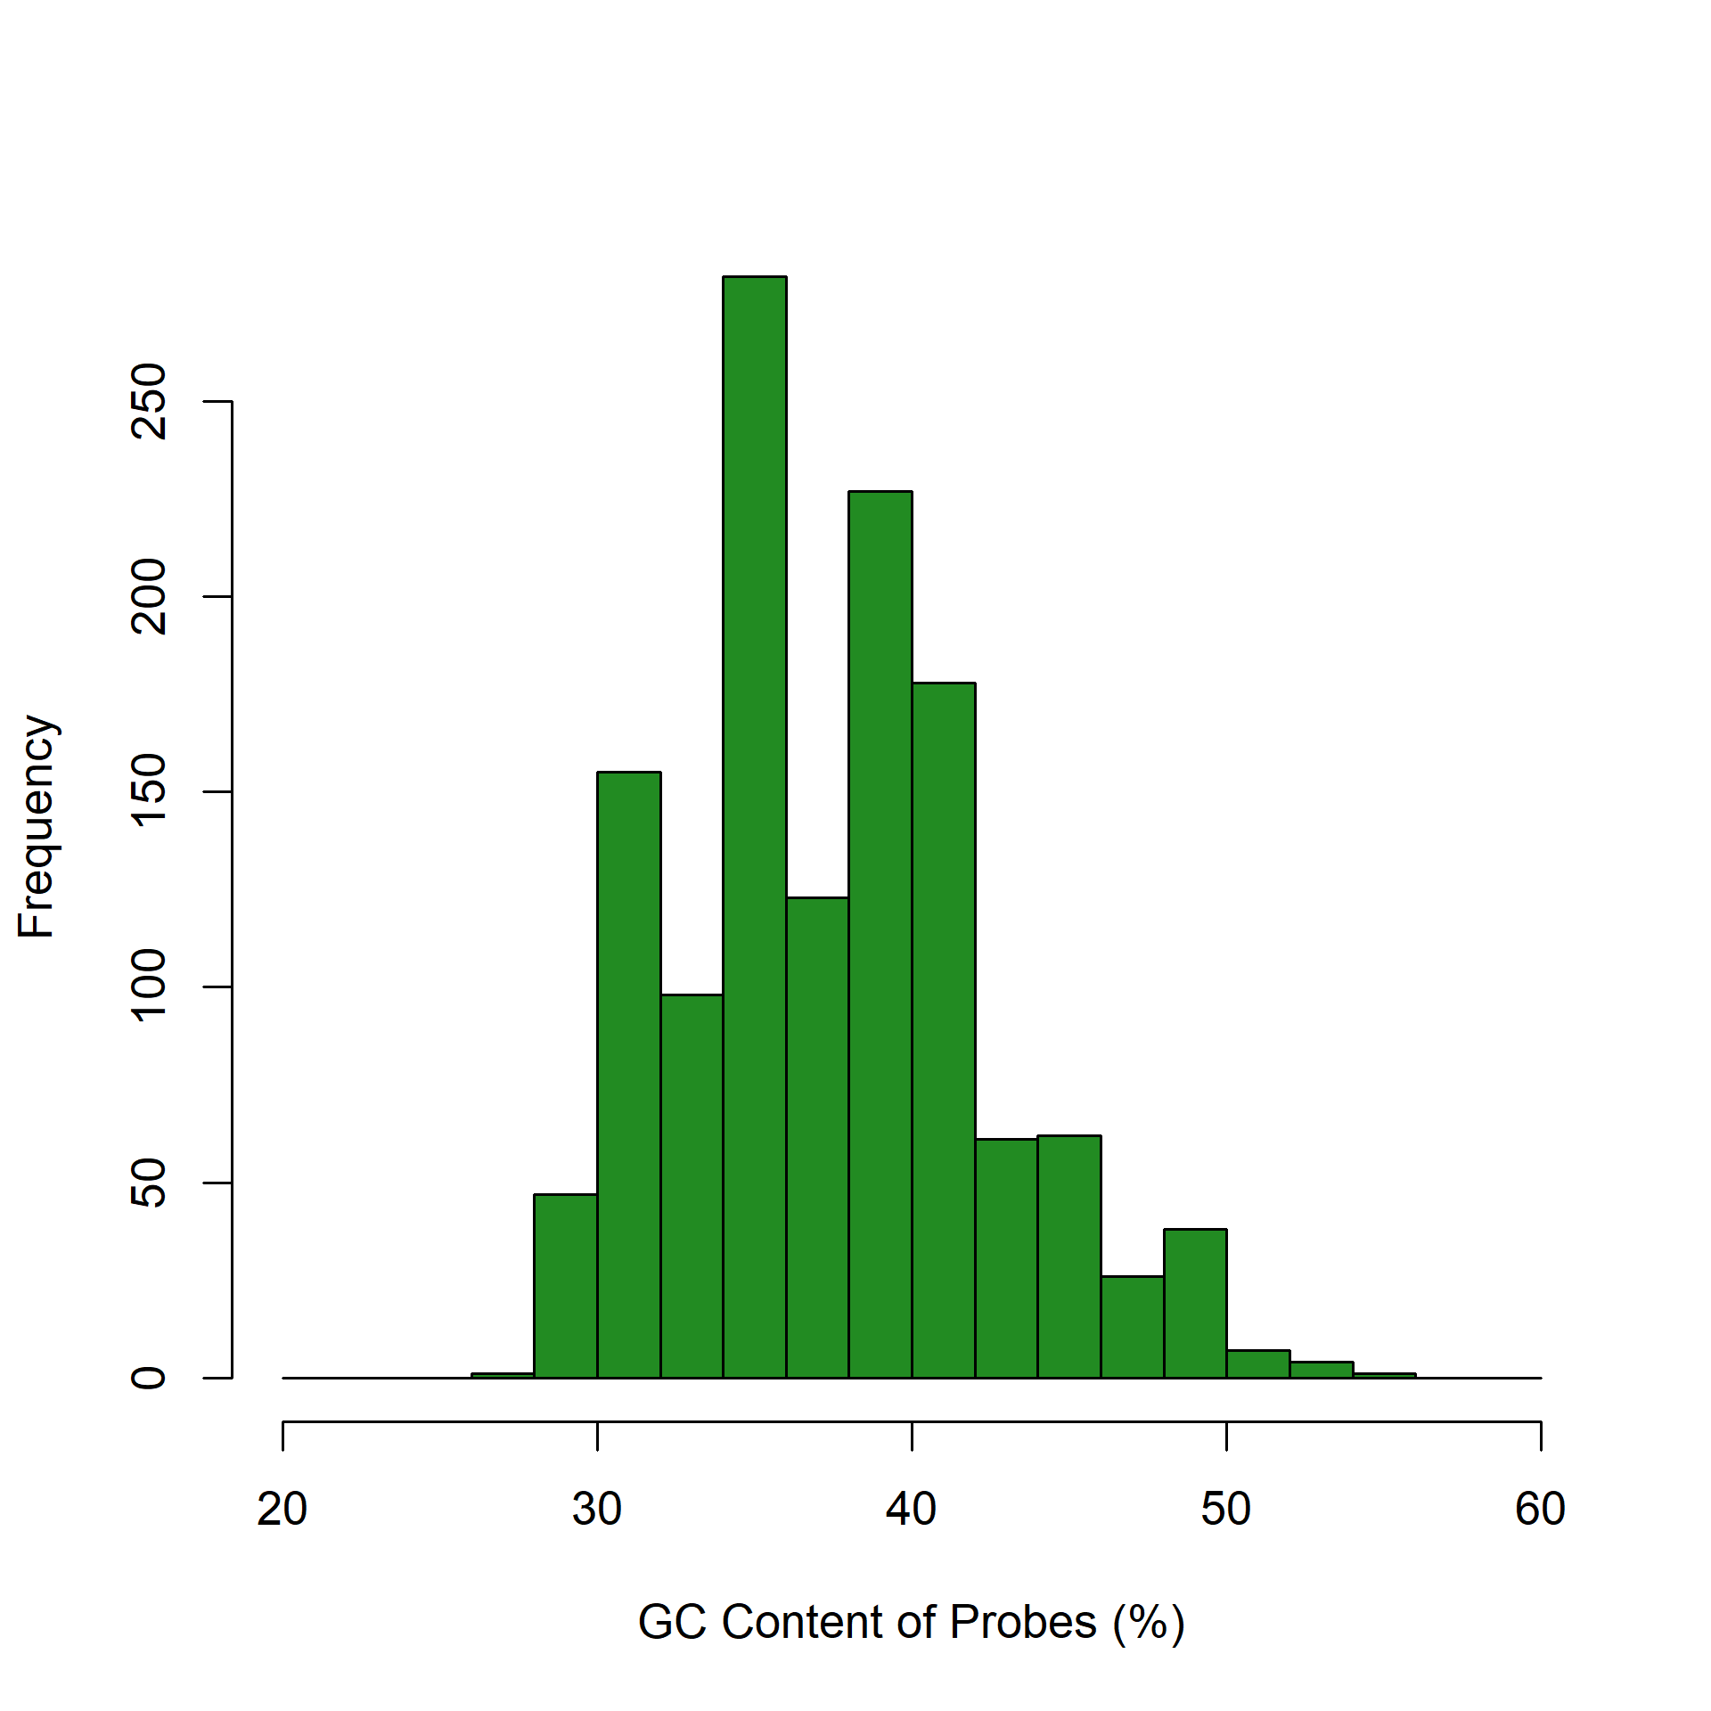
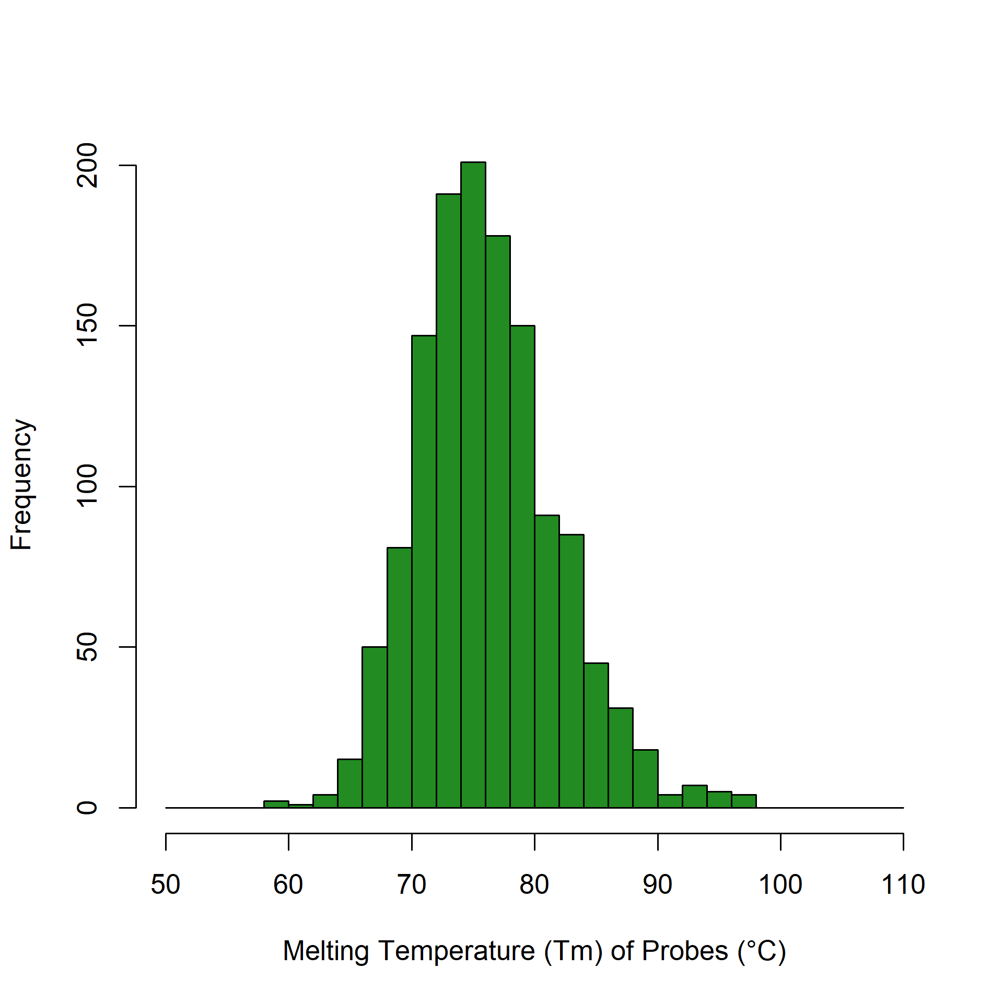
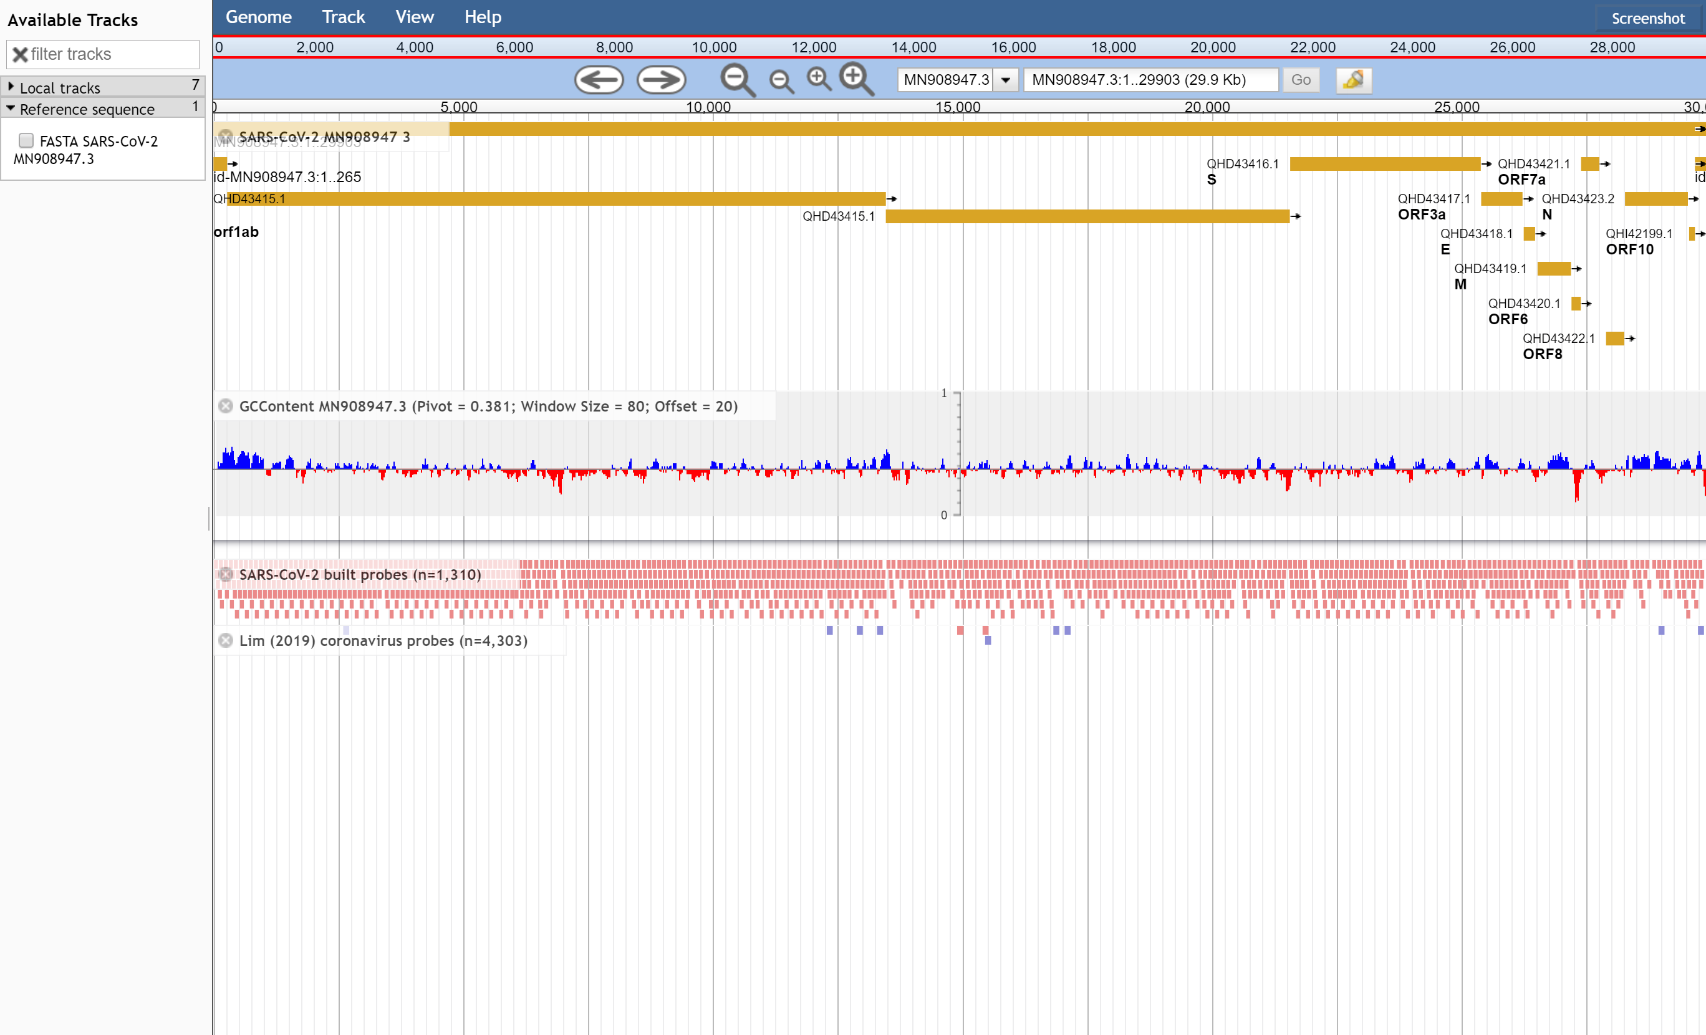
Winter 2020 – SARS-CoV-2 Bait Capture
SARS-CoV-2 Bait Capture Probe Set
https://github.com/jaleezyy/covid-19-baits
Nasir, J.A., D.J. Speicher, R.A. Kozak, H.N. Poinar, M.S. Miller, & A.G. McArthur. 2020. Rapid design of a bait capture platform for culture- and amplification-free next-generation sequencing of SARS-CoV-2. Preprints 2020, 2020020385.
Jalees Nasir, PhD Student (McArthur Lab)

Slide 11
Winter 2020 – SARS-CoV-2 Bait Capture
SARS-CoV-2 Bait Capture Probe Set
https://github.com/jaleezyy/covid-19-baits
Nasir, J.A., D.J. Speicher, R.A. Kozak, H.N. Poinar, M.S. Miller, & A.G. McArthur. 2020. Rapid design of a bait capture platform for culture- and amplification-free next-generation sequencing of SARS-CoV-2. Preprints 2020, 2020020385.
Jalees Nasir, PhD Student (McArthur Lab)

Slide 12
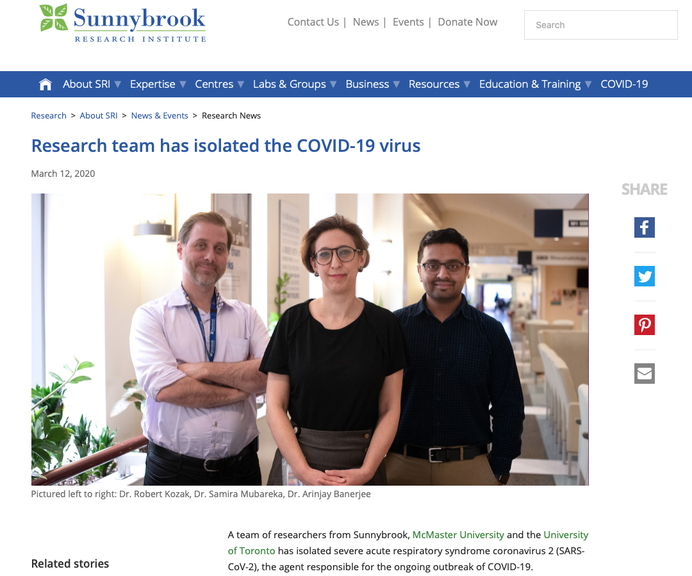
Banerjee et al. 2020. Isolation, sequence, infectivity and replication kinetics of SARS-CoV-2. Emerging Infectious Diseases, 26, 2054-2063.

Slide 13
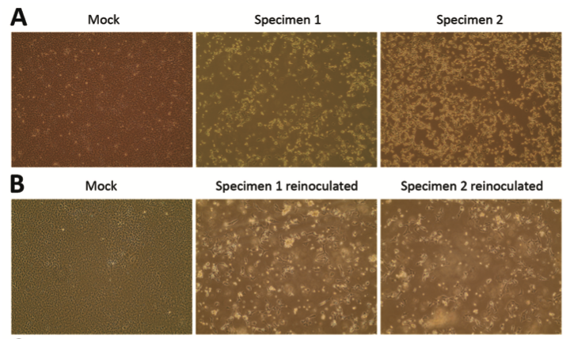
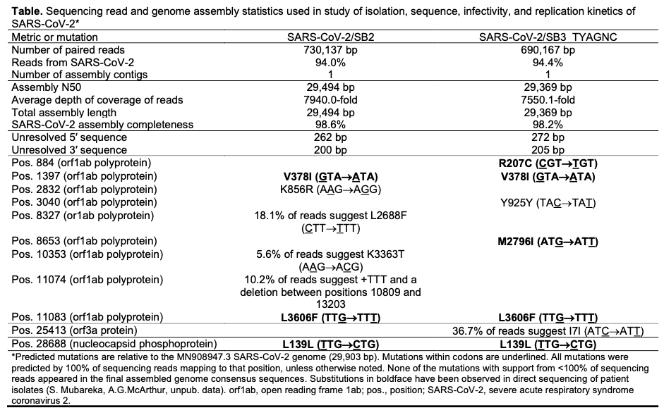
Banerjee et al. 2020. Isolation, sequence, infectivity and replication kinetics of SARS-CoV-2. Emerging Infectious Diseases, 26, 2054-2063.

Slide 14


Slide 15
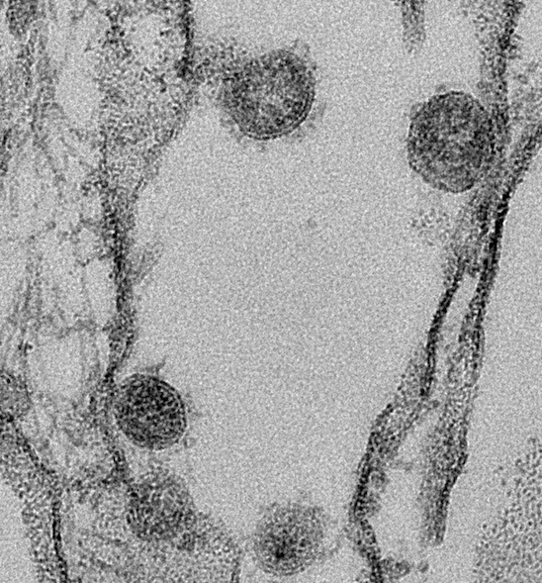
Why sequence SARS-CoV-2?
Validation of in vitro experiments
Image courtesy of Arinjay Banerjee

Slide 16
Why sequence SARS-CoV-2?
Validation of in vitro experiments
Diagnostic escape
Vaccine escape
Image courtesy of Arinjay Banerjee

Slide 17
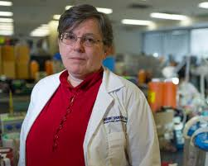
Why sequence SARS-CoV-2?
Validation of in vitro experiments
Diagnostic escape
Vaccine escape
Changing biology – infectivity, virulence
Re-infection & immunity
Environmental transmission
Image courtesy of Arinjay Banerjee
Allison McGeer - Mount Sinai Hospital

Slide 18
Why sequence SARS-CoV-2?
Validation of in vitro experiments
Diagnostic escape
Vaccine escape
Changing biology – infectivity, virulence
Re-infection & immunity
Environmental transmission
Global and community transmission
Outbreak dynamics
Image courtesy of Arinjay Banerjee
Allison McGeer - Mount Sinai Hospital

Slide 19
Why sequence SARS-CoV-2?
Validation of in vitro experiments
Diagnostic escape
Vaccine escape
Changing biology – infectivity, virulence
Re-infection & immunity
Environmental transmission
Global and community transmission
Outbreak dynamics
Image courtesy of Arinjay Banerjee
Allison McGeer - Mount Sinai Hospital

Slide 20
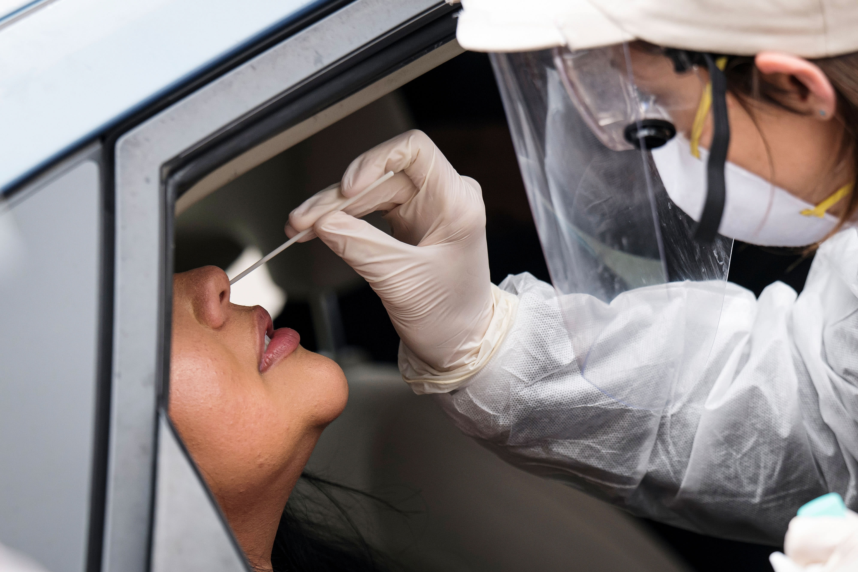
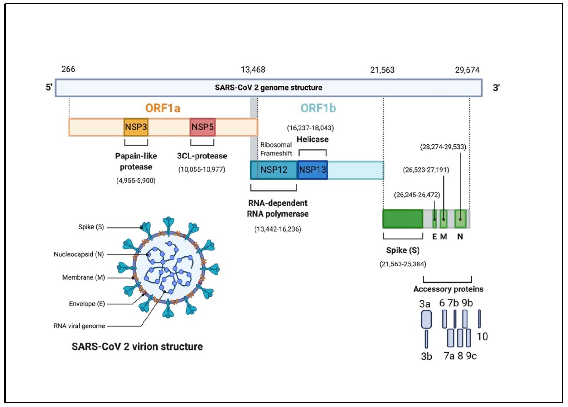
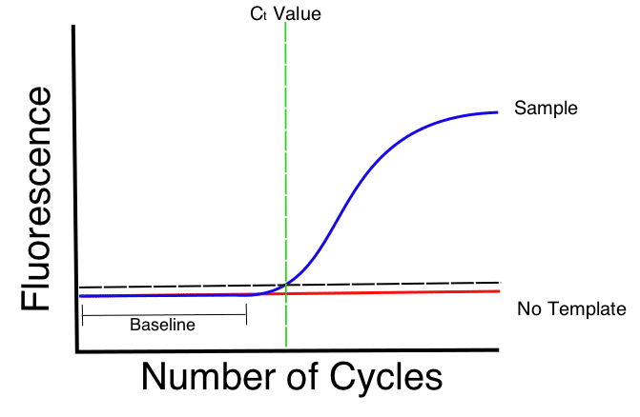
Diagnostic Escape Mutations
SeeGene; Assay: Allplex COVID assay - can detect 3 different genes - RdRp, Envelope and Nucleocapsid
Roche; Assay: Cobas SARS-CoV-2 assay - can detect 2 genes, ORF1ab gene (Target 1) and Envelope gene (Target 2)
Altona Diagnostics; Assay: RealStar SARS-CoV-2 assay - can detect the Spike and Envelope gene
BGI Genomics; MGI SARS-CoV-2 Assay – detects the ORF1ab gene
Hamilton Regional Laboratory Medicine Program; Assay: SARS-CoV-2 – detects 2-3 different viral genes
Public Health Ontario Laboratory; Assay: SARS-CoV-2 – detects 2 different viral gene targets

Slide 21
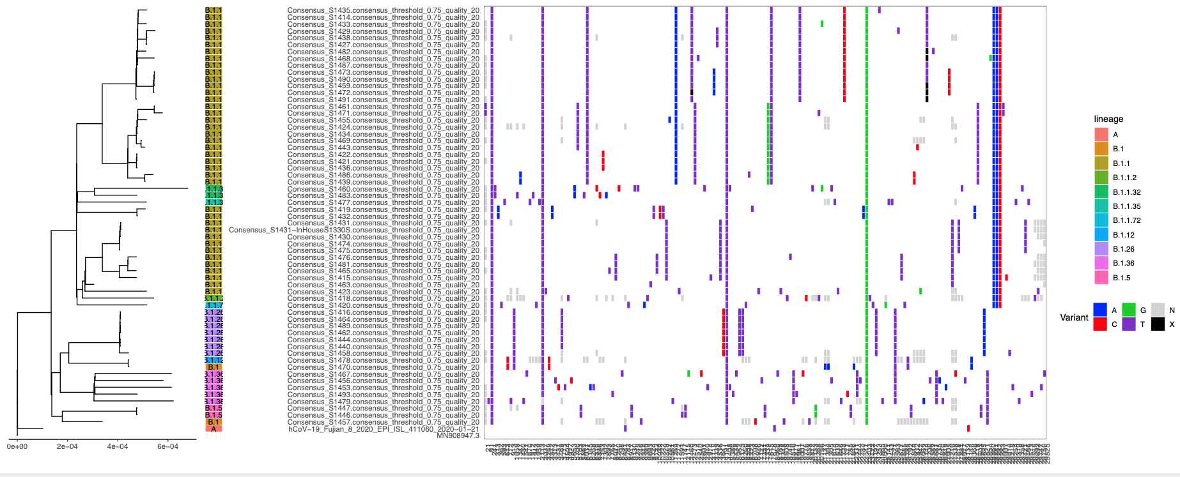
What is the risk for Escape Mutations?
~28,000 bp genome
Intrinsic mutation rate is low due to nonstructural protein 14 (nsp14): 3′-to-5′ exoribonuclease (ExoN) and guanine-N7-methyltransferase (N7-MTase) activities
Risk of diagnostic or vaccine escape mutations low
Risk of mutations that change biological properties low
Genome analysis must be intolerant of sequencing error!

Slide 22
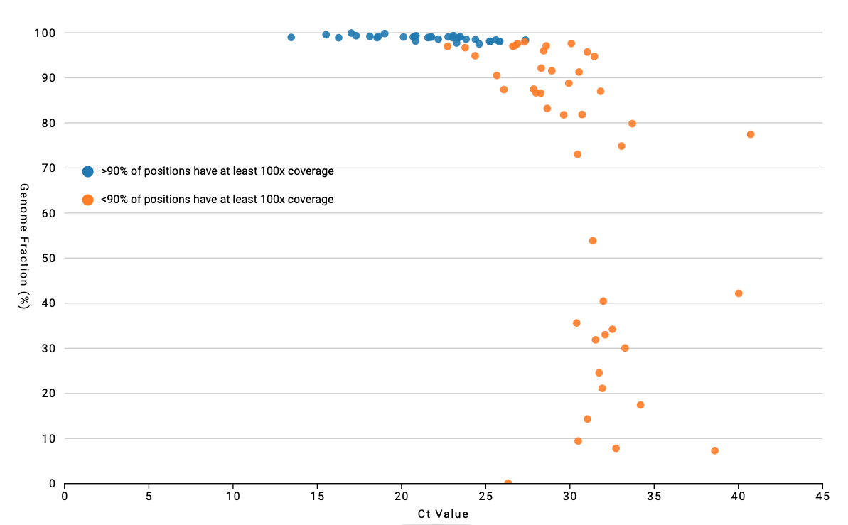
Problems with Sequencing Error

Slide 23
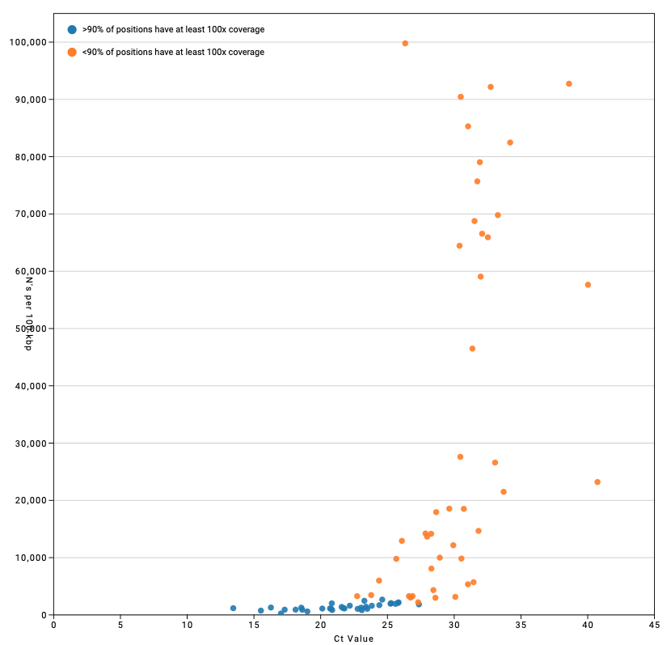
Problems with Sequencing Error

Slide 24
What is the risk for Escape Mutations?
Population Biology
What is the intrinsic mutation rate low
How much time has passed, i.e. generations of replication not much
How big is the population, i.e. how many have been infected? 33M+
Is the population expanding or contracting? Bottlenecks? varies
Potential for recombination? Arinjay
Selective pressures? D614G
increased thermostability*
* Long et al. 2020. medRxiv 2020.09.22.20199125.

Slide 25
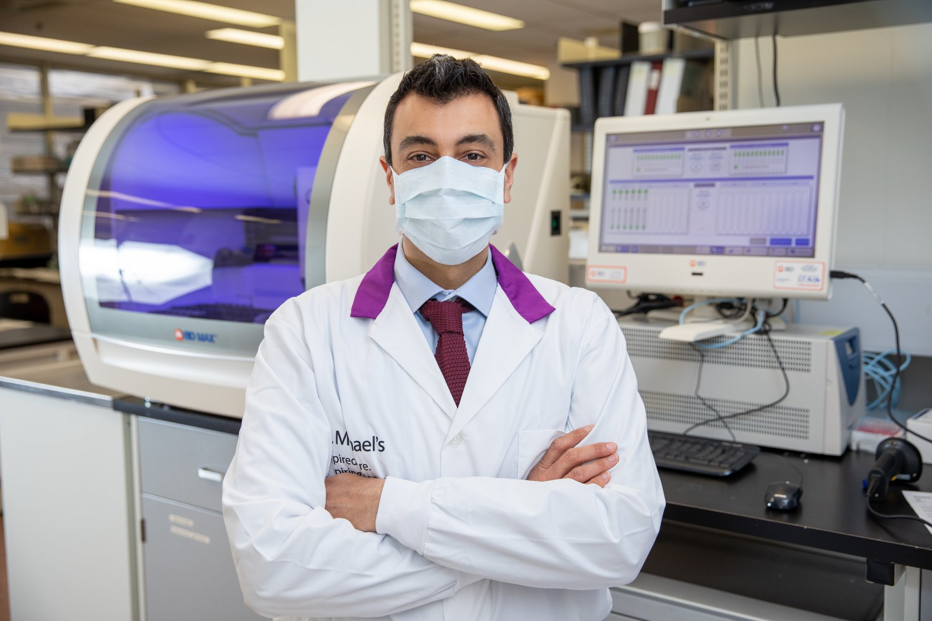
Diagnostic Escape Mutations
Ramzi Fattouh
Clinical Microbiologist | Dept. of Lab Medicine
St. Michael's Hospital, Toronto
SeeGene; Assay: Allplex COVID assay - can detect 3 different genes - RdRp, Envelope and Nucleocapsid
Roche; Assay: Cobas SARS-CoV-2 assay - can detect 2 genes, ORF1ab gene (Target 1) and Envelope gene (Target 2)
Altona Diagnostics; Assay: RealStar SARS-CoV-2 assay - can detect the Spike and Envelope gene
BGI Genomics; MGI SARS-CoV-2 Assay – detects the ORF1ab gene
Hamilton Regional Laboratory Medicine Program; Assay: SARS-CoV-2 – detects 2-3 different viral genes
Public Health Ontario Laboratory; Assay: SARS-CoV-2 – detects 2 different viral gene targets

Slide 26
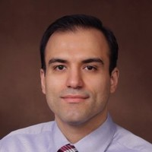
How do we sequence SARS-CoV-2?
Patryk Aftanas
(Sunnybrook)
Mike Surette
Hooman Derakhshani
(PDF, McMaster)

Slide 27
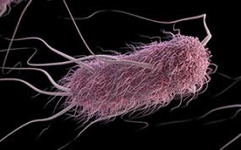
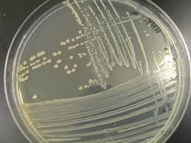
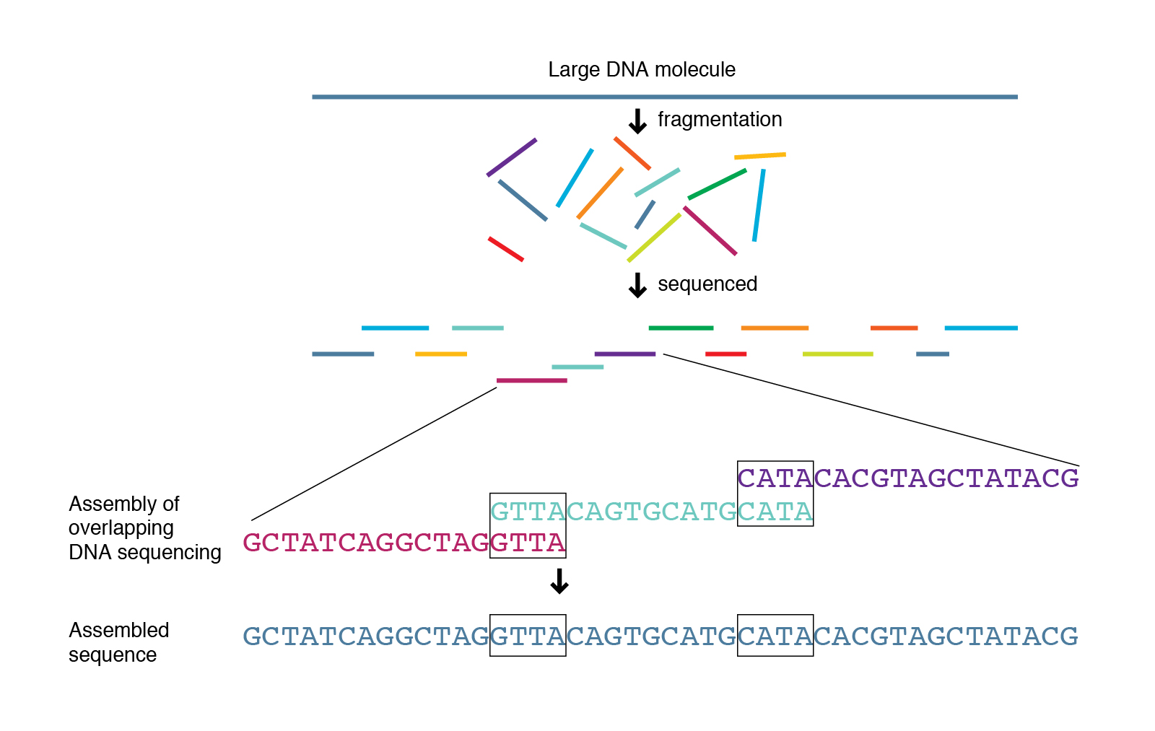
How do we sequence SARS-CoV-2?
E. coli
Culture to obtain large amount of clean DNA of pathogen
Random fragmentation of DNA – each part of the genome is equally sampled
Graph based computational assembly of the consensus genome
Highly redundant sequencing of each nucleotide; at least 100x
Sequencing error is nearly random; overcome by redundancy

Slide 28
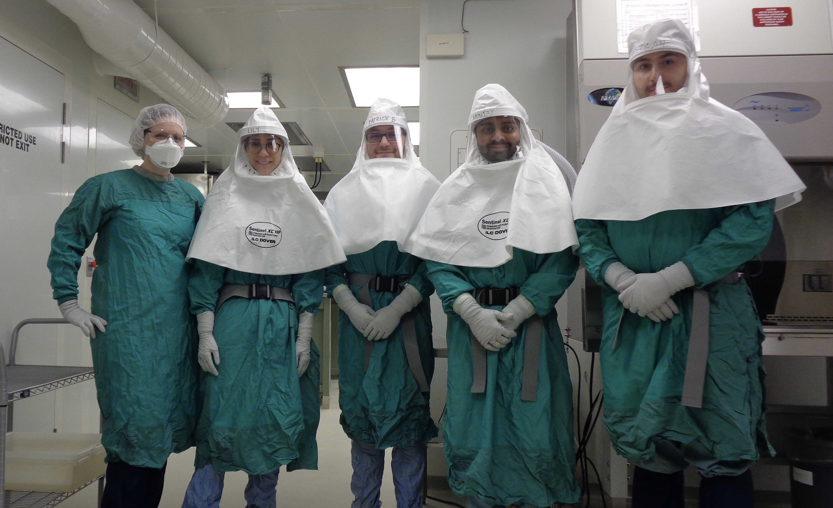
How do we sequence SARS-CoV-2?
BSL3
Arinjay Banerjee and friends

Slide 29
How do we sequence SARS-CoV-2?
cDNA
reverse transcriptase
Overlapping PCR Amplicons -> Illumina Sequencing
Liverpool – 30 amplicons
ARTIC3 – 98 amplicons

Slide 30
How do we sequence SARS-CoV-2?
cDNA
reverse transcriptase
Overlapping PCR Amplicons -> Illumina Sequencing
Culture to obtain large amount of clean DNA of pathogen
Random fragmentation of DNA – each part of the genome is equally sampled
Graph based computational assembly of the consensus genome
Highly redundant sequencing of each nucleotide; at least 100x
Sequencing error is nearly random; overcome by redundancy
Liverpool – 30 amplicons
ARTIC3 – 98 amplicons

Slide 31
How do we sequence SARS-CoV-2?
cDNA
reverse transcriptase
Overlapping PCR Amplicons -> Illumina Sequencing
Patient DNA!
Culture to obtain large amount of clean DNA of pathogen
Random fragmentation of DNA – each part of the genome is equally sampled
Graph based computational assembly of the consensus genome
Highly redundant sequencing of each nucleotide; at least 100x
Sequencing error is nearly random; overcome by redundancy
Liverpool – 30 amplicons
ARTIC3 – 98 amplicons

Slide 32
How do we sequence SARS-CoV-2?
cDNA
reverse transcriptase
Overlapping PCR Amplicons -> Illumina Sequencing
Patient DNA!
Culture to obtain large amount of clean DNA of pathogen
Random fragmentation of DNA – each part of the genome is equally sampled
Graph based computational assembly of the consensus genome
Highly redundant sequencing of each nucleotide; at least 100x
Sequencing error is nearly random; overcome by redundancy
Liverpool – 30 amplicons
ARTIC3 – 98 amplicons

Slide 33
How do we sequence SARS-CoV-2?
cDNA
reverse transcriptase
Overlapping PCR Amplicons -> Illumina Sequencing
Patient DNA!
Culture to obtain large amount of clean DNA of pathogen
Random fragmentation of DNA – each part of the genome is equally sampled
Graph based computational assembly of the consensus genome
Highly redundant sequencing of each nucleotide; at least 100x
Sequencing error is nearly random; overcome by redundancy
10x coverage
Liverpool – 30 amplicons
ARTIC3 – 98 amplicons

Slide 34
How do we sequence SARS-CoV-2?
cDNA
reverse transcriptase
Overlapping PCR Amplicons -> Illumina Sequencing
Patient DNA!
Culture to obtain large amount of clean DNA of pathogen
Random fragmentation of DNA – each part of the genome is equally sampled
Graph based computational assembly of the consensus genome
Highly redundant sequencing of each nucleotide; at least 100x
Sequencing error is nearly random; overcome by redundancy
10x coverage
Liverpool – 30 amplicons
ARTIC3 – 98 amplicons

Slide 36
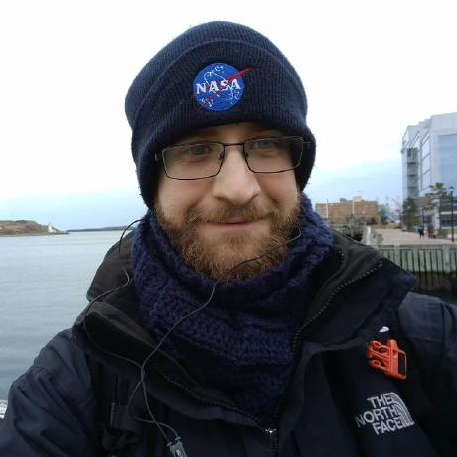
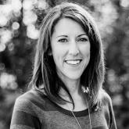
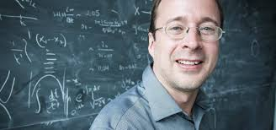
SIGNAL: SARS-CoV-2 Illumina GeNome Assembly Line
https://github.com/jaleezyy/covid-19-signal
J.A. Nasir
R.A. Kozak
P. Aftanas
A.R. Raphenya
K.M. Smith
F. Maguire
H. Maan
M. Alruwaili
A. Banerjee
H. Mbareche
B.P. Alcock
N.C. Knox
K. Mossman
B. Wang
J.A. Hiscox
A.G. McArthur
S. Mubareka
Jalees Nasir
Amos Raphenya
Kendrick Smith (Perimeter Institute)
Finlay Maguire (Dalhousie)
Natalie Knox (PHAC)
Nasir et al. 2020. Viruses, 12, 895.

Slide 37
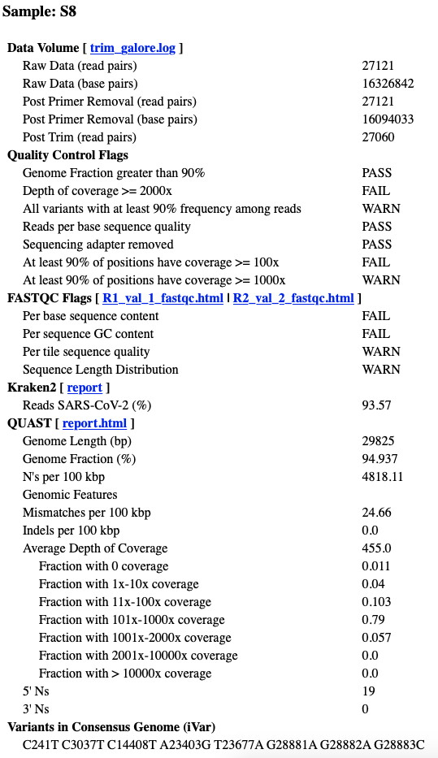
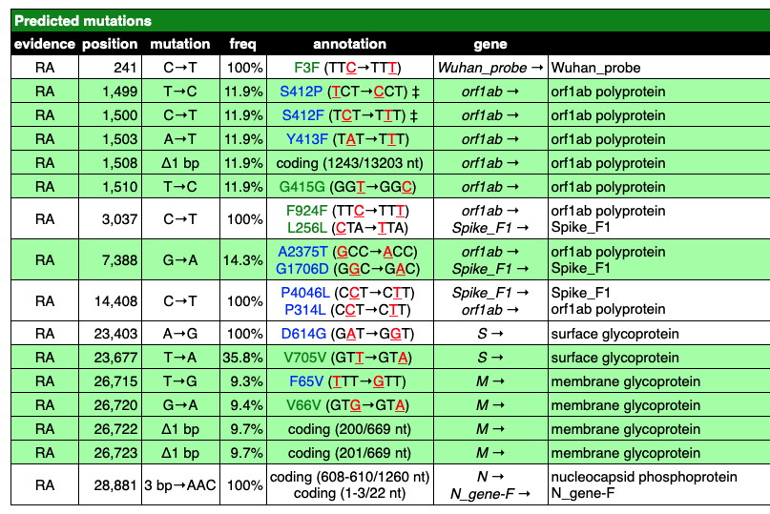
SIGNAL: SARS-CoV-2 Illumina GeNome Assembly Line
https://github.com/jaleezyy/covid-19-signal
J.A. Nasir
R.A. Kozak
P. Aftanas
A.R. Raphenya
K.M. Smith
F. Maguire
H. Maan
M. Alruwaili
A. Banerjee
H. Mbareche
B.P. Alcock
N.C. Knox
K. Mossman
B. Wang
J.A. Hiscox
A.G. McArthur
S. Mubareka
Jalees Nasir
Amos Raphenya
Nasir et al. 2020. Viruses, 12, 895.

Slide 38

SIGNAL: SARS-CoV-2 Illumina GeNome Assembly Line
https://github.com/jaleezyy/covid-19-signal
Viral concentration (Ct value) is the most important predictor of success
ARTIC3 provides highest depth of coverage of the SARS-CoV-2 genome; but dropped amplicons
LIVERPOOL provides the most even coverage of the SARS-CoV-2 genome
Bait capture enrichment provides results on par with sequencing amplicons
Bait capture very useful for determining PCR artifacts
Nasir et al. 2020. Viruses, 12, 895.

Slide 39


NCoV-Tools: Quality control for SARS-CoV-2 sequencing
https://github.com/jts/ncov-tools
Jared Simpson (OICR)

Slide 40

CanCOGeN
Sequence 150,000 representative SARS-CoV-2 genomes from across Canada

Slide 41



CanCOGeN
Sequence 150,000 representative SARS-CoV-2 genomes from across Canada
Amos Raphenya
Andrew McArthur
Ahmed Draia
Emily Panousis
Mike Surette
Hooman Derakhshani

Slide 42
CanCOGeN
British Columbia
Centralized public health approach – BC Centre for Disease Control
All testing, sequencing, and data collection goes through one provincial agency
Ability to cross-analyze sequence and clinical information

Slide 43
CanCOGeN
British Columbia
Centralized public health approach – BC Centre for Disease Control
All testing, sequencing, and data collection goes through one provincial agency
Ability to cross-analyze sequence and clinical information
Ontario
Distributed surveillance model
Public Health Ontario (PHOL) handles ~35% of positive COVID-19 samples
65% of testing and samples handled by 2 main public hospital laboratories, 4 community laboratories, and 29 affiliated laboratories
PHOL primary focusses on outbreaks – we rely on our healthcare centre partners to examine community transmission of SARS-CoV-2
No existing framework for sharing samples or data
PHOL requires academic partners: McMaster University, Ontario Institute for Cancer Research, Canadore College

Slide 44

Ahmed Draia
Emily Panousis

Slide 45

McMaster’s Sequences
Sinai
Hamilton
Sunnybrook
EORLA (Ottawa)
THP
London
HSC
HSN
Halton
Unity Health
Grand River
Kingston
Lifelabs
Dynacare
~1300 First Wave + Summer genomes sequenced
405 March
71 April
32 May
3 June
0 July
61 August
1910s 1 *
1920s 5 *****
1930s 19 *******************
1940s 26 **************************
1950s 57 *********************************************************
1960s 37 *************************************
1970s 26 **************************
1980s 32 ********************************
1990s 21 *********************
2000s 8 ********
2010s 2 **

Slide 46

The Story so far…
Maan et al. 2020. Genotyping SARS-CoV-2 through an interactive web application. The Lancet Digital Health, 2, e340–e341.

Slide 47

The Story so far…
https://nextstrain.org

Slide 48

The Story so far…
Finlay Maguire (Dalhousie)

Slide 49


The Story so far…
Finlay Maguire (Dalhousie)

Slide 50

The Story so far…
****

Slide 51

The Story so far…

Slide 52

The Story so far…

Slide 53
The Story so far…
Selective pressures? D614G
increased thermostability*

Slide 55
The Second Wave, The Border, & LTC Outbreaks
If diversity is low, every infection starts to look the same
Patterns of community transmission become hard to resolve
This requires high resolution metadata: date of collection, partial postal code, travel history (within province)

Slide 56
The Second Wave, The Border, & LTC Outbreaks
If diversity is low, every infection starts to look the same
Patterns of community transmission become hard to resolve
This requires high resolution metadata: date of collection, partial postal code, travel history (within province)
Diversity in the USA is very high since the virus is still undergoing population expansion
When we open the borders, sequencing should be able to differentiate between a community outbreak and cross-border infection

Slide 57


The Second Wave, The Border, & LTC Outbreaks
If diversity is low, every infection starts to look the same
Patterns of community transmission become hard to resolve
This requires high resolution metadata: date of collection, partial postal code, travel history (within province)
Diversity in the USA is very high since the virus is still undergoing population expansion
When we open the borders, sequencing should be able to differentiate between a community outbreak and cross-border infection
Virus genome sequences in a Long-Term Care facility outbreak will be identical in consensus sequence
Also may look the same as the surrounding community
Analogous to Canada’s northern tuberculosis crisis
Deep Sequencing!
Robyn Lee
(Nunavik Regional Board of Health)

Slide 58
Thanks!
McArthur Lab
Jalees Nasir, Amos Raphenya, Emily Panousis, Ahmed Draia & my very patient lab
McMaster
Mike Surette, Hooman Derakhshani, Arinjay Banerjee, Farncombe Sequencing Team, MILO, CSU, HiREB, Gina Mannen, Gerry Wright, Karen Mossman
ONCoV, ONS2, Sunnybrook
Jared Simpson, Samira Mubareka, Rob Kozak, Robyn Lee, Ramzi Fattouh, Hamza Mbareche, Kyuganya Nirmalarajah, Patryk Aftanas , and so many more…
CanCOGeN
Gary Van Domselaar, Natalie Knox, and the many working groups (QC & BC especially!)
The ‘Hackers’
Finlay Maguire, Kendrick Smith, Hassaan Maan, Bo Wang, DNAStack

Slide 59





Thanks!

Slide 60
End

